Slide 1
Topic: Trigonometry
EQ: What are the key trigonometric relationships I need to know?

Slide 2
Topic: Trigonometry EQ: What are the key trigonometric ratios I need to know?
Summary:

Slide 3
Topic: Trigonometry EQ: What are the key trigonometric ratios I need to know?
Trigonometry means “triangle” and “measurement”.
We will be using right-angled triangles.
Opposite
hypotenuse
a°
Adjacent

Slide 4
Topic: Trigonometry EQ: What are the key trigonometric ratios I need to know?
Parts of a Right Triangle
Imagine that you are at Angle A, looking at the triangle:
The hypotenuse will always be the longest side, and opposite from the right angle.
The opposite side is the side that is on the opposite side of the triangle from Angle A.
The adjacent side is the side next to Angle A.

Slide 5
Topic: Trigonometry EQ: What are the key trigonometric ratios I need to know?
Important to know: How you label the sides of the triangle depends on what angle you are viewing from
Hypotenuse
Opposite
θ
Adjacent

Slide 6
Topic: Trigonometry EQ: What are the key trigonometric ratios I need to know?
Parts of a Right Triangle
Now imagine that we have moved from Angle A to Angle B:
From Angle B the opposite side is the side that is on the opposite side of the triangle.
From Angle B the adjacent side is the side next to Angle B.

Slide 7
Topic: Trigonometry EQ: What are the key trigonometric ratios I need to know?
Important to know:
θ
Hypotenuse
Adjacent
Opposite

Slide 8
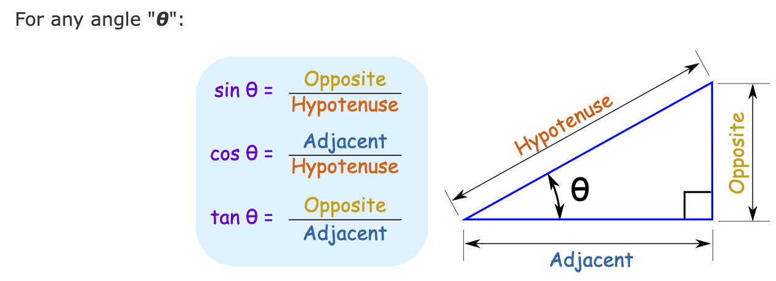
Topic: Trigonometry EQ: What are the key trigonometric ratios I need to know?
Trigonometry Ratios
The main trigonometric ratios are sine, cosine and tangent, abbreviated sin, cos, tan
They are simply one side of a right-angled triangle divided by another, as below:

Slide 9
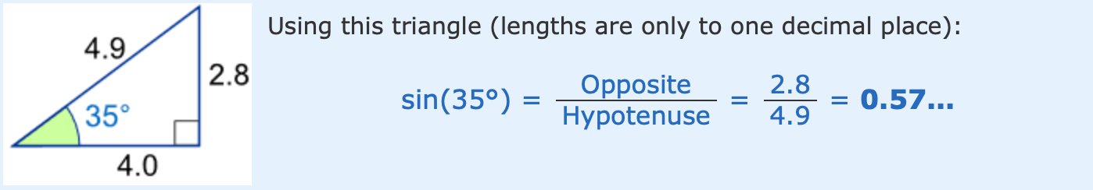
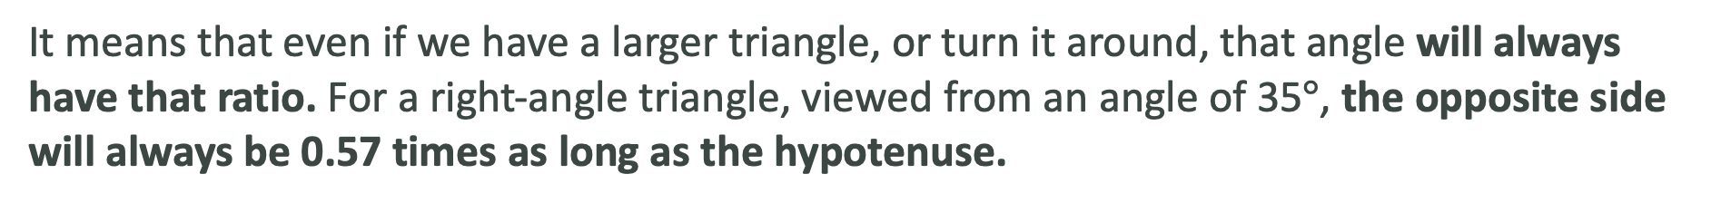
Topic: Trigonometry EQ: What are the key trigonometric ratios I need to know?
But what does this 0.57 mean?
It means that even if we have a larger triangle, or turn it around, that angle will always have that ratio. For a right-angle triangle, viewed from an angle of 35$°$, the opposite side will always be 0.57 times as long as the hypotenuse.

Slide 10
Topic: Trigonometry EQ: What are the key trigonometric ratios I need to know?
Finding sin, cos, and tan. (Just writing a ratio or decimal.)

Slide 11
Topic: Trigonometry EQ: What are the key trigonometric ratios I need to know?
Find the sine, the cosine, and the tangent of angle A.
Give a fraction and decimal answer (round to 4 places).
10.8
9
A
6
Shrink yourself down and stand where the angle is.
Now, figure out your ratios.

Slide 12
Topic: Trigonometry EQ: What are the key trigonometric ratios I need to know?
Find the sine, the cosine, and the tangent of angle A.
24.5
Give a fraction and decimal answer (round to 4 decimal places).
8.2
A
23.1
Shrink yourself down and stand where the angle is.
Now, figure out your ratios.

Slide 13
Topic: Trigonometry EQ: What are the key trigonometric ratios I need to know?
Homework: Mathspace Task – Trig Ratios
Complete your summary
Summary:

